Slide 1
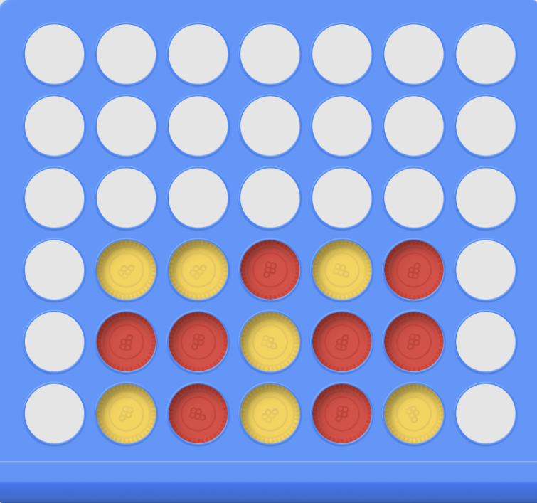
ConnectZ: An Enhanced Connect Game with Intelligent AI
Name: Syed Mohammed Farhan
Date: 11.04.2024 Student ID: 903724141
Course: CSE-6633 (Introduction to Artificial Intelligence)

Slide 2

Game Overview
Introduction to ConnectZ:
A strategic board game inspired by the classic Connect Four.
Played on a 10x10 grid aiming to align 5 consecutive pieces.
Unique Features:
Power Moves: Each player has 3 opportunities to remove an opponent's piece.
Block Moves: Each player can block a cell once, preventing the opponent from placing there and earning an additional move.
AI Integration:
Utilizes Minimax Algorithm with Alpha-Beta Pruning for optimal decision-making.
Incorporates Heuristic Evaluation to assess board states efficiently.
Technologies Used:
Programming Language: Python
GUI Framework: Tkinter
Libraries: NumPy for board management, threading for AI responsiveness.

Slide 3
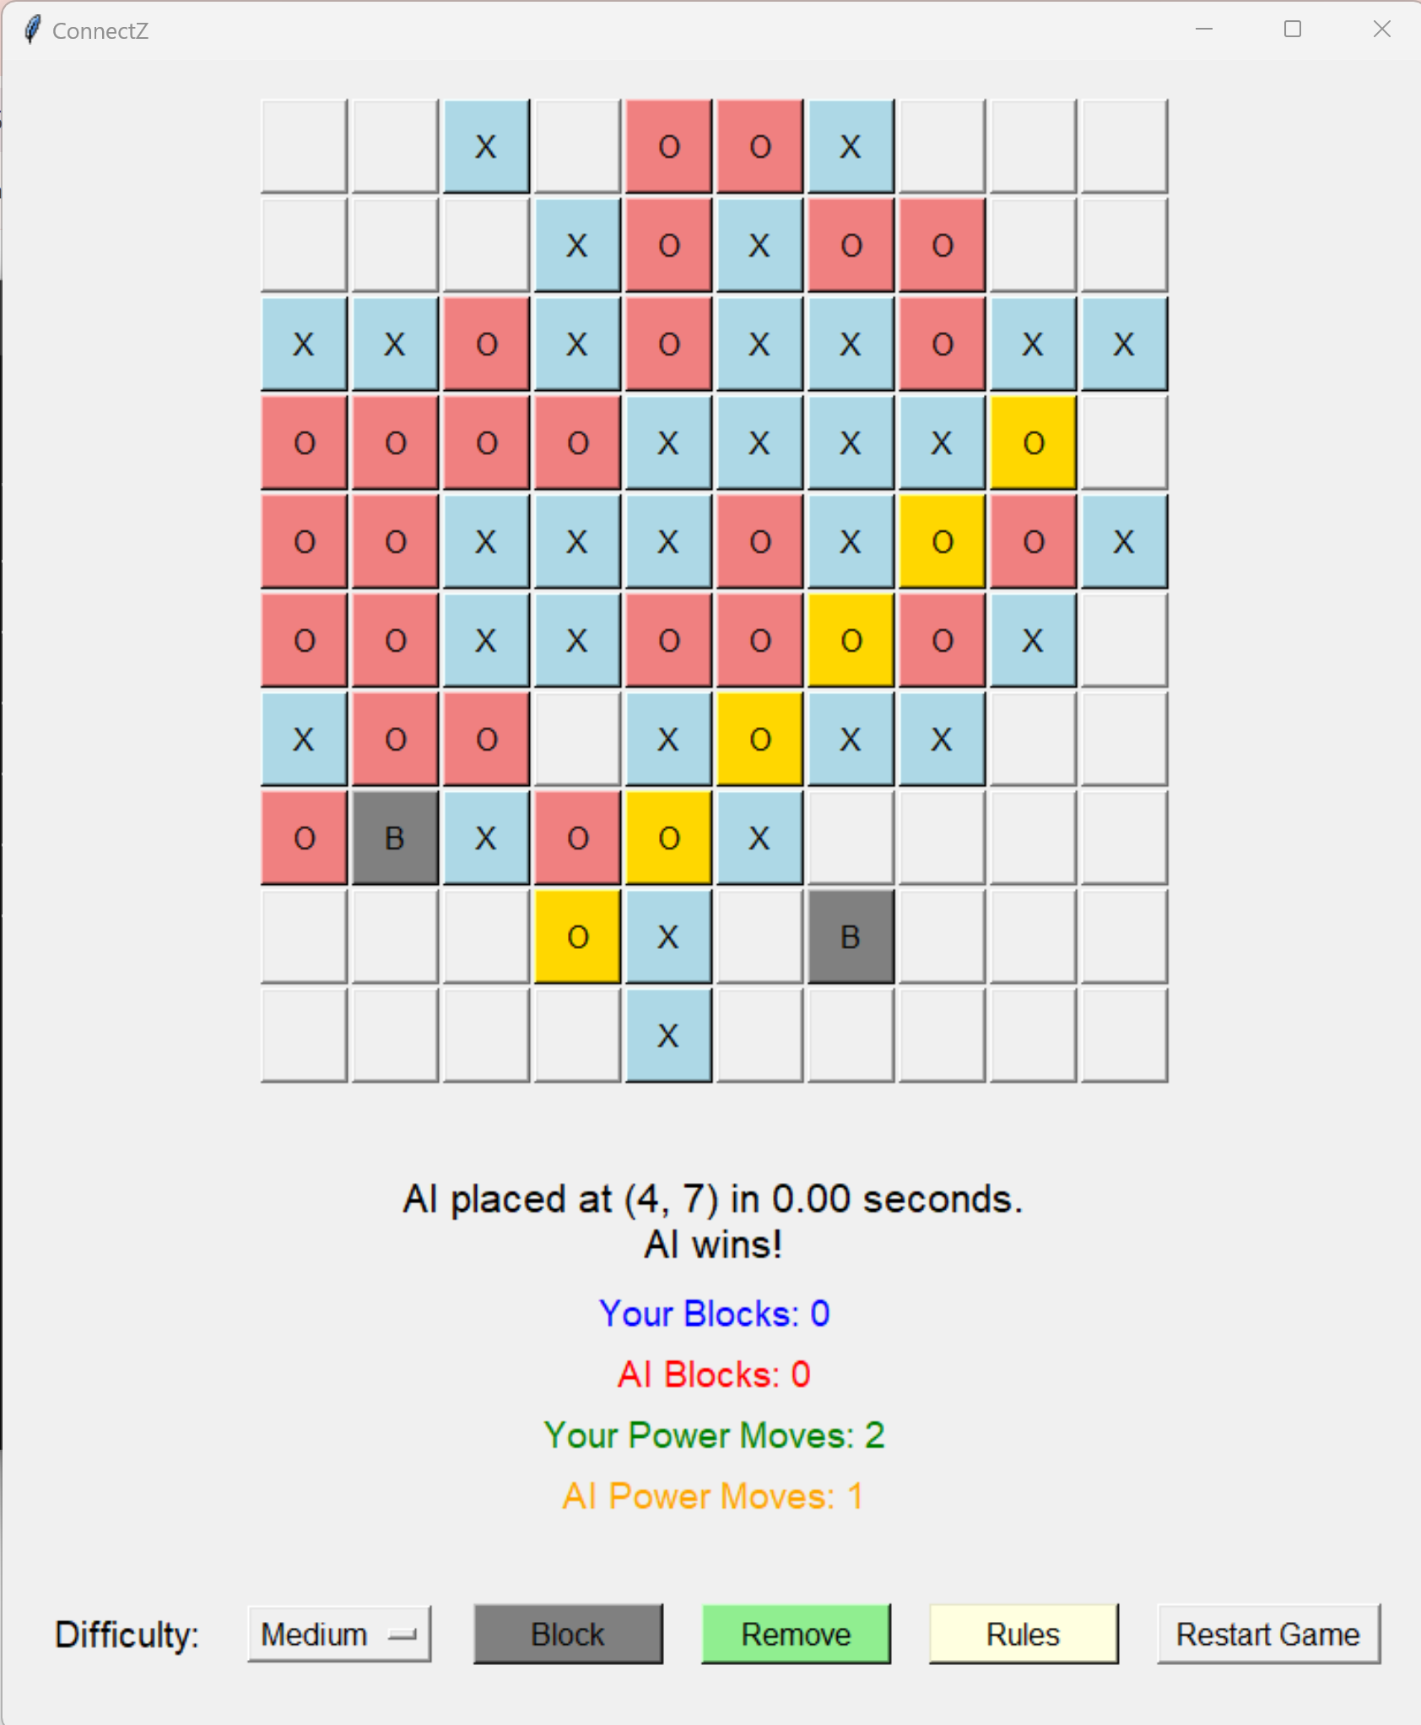
ConnectZ: Rules and Objectives
Objective:
Align 5 consecutive pieces horizontally, vertically, or diagonally to win.
Players:
Human Player (X): Initiates the game.
AI Player (O): Responds to human moves.
Turn Order:
Player X starts, followed by Player O (AI), alternating turns unless a block move grants an extra turn.

Slide 4
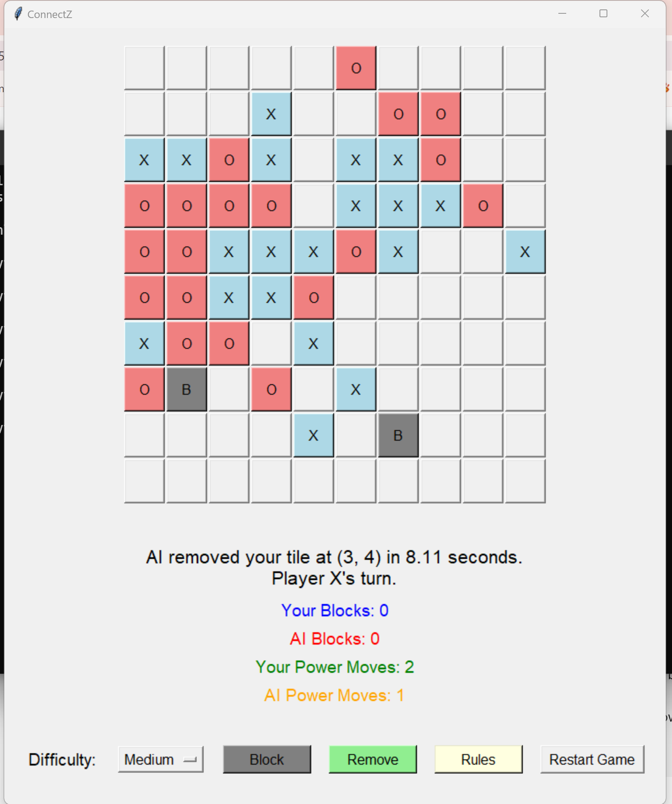
ConnectZ: Special Moves
Power Moves:
Usage: Up to 3 times per game.
Function: Remove an opponent's piece from the board.

Slide 5
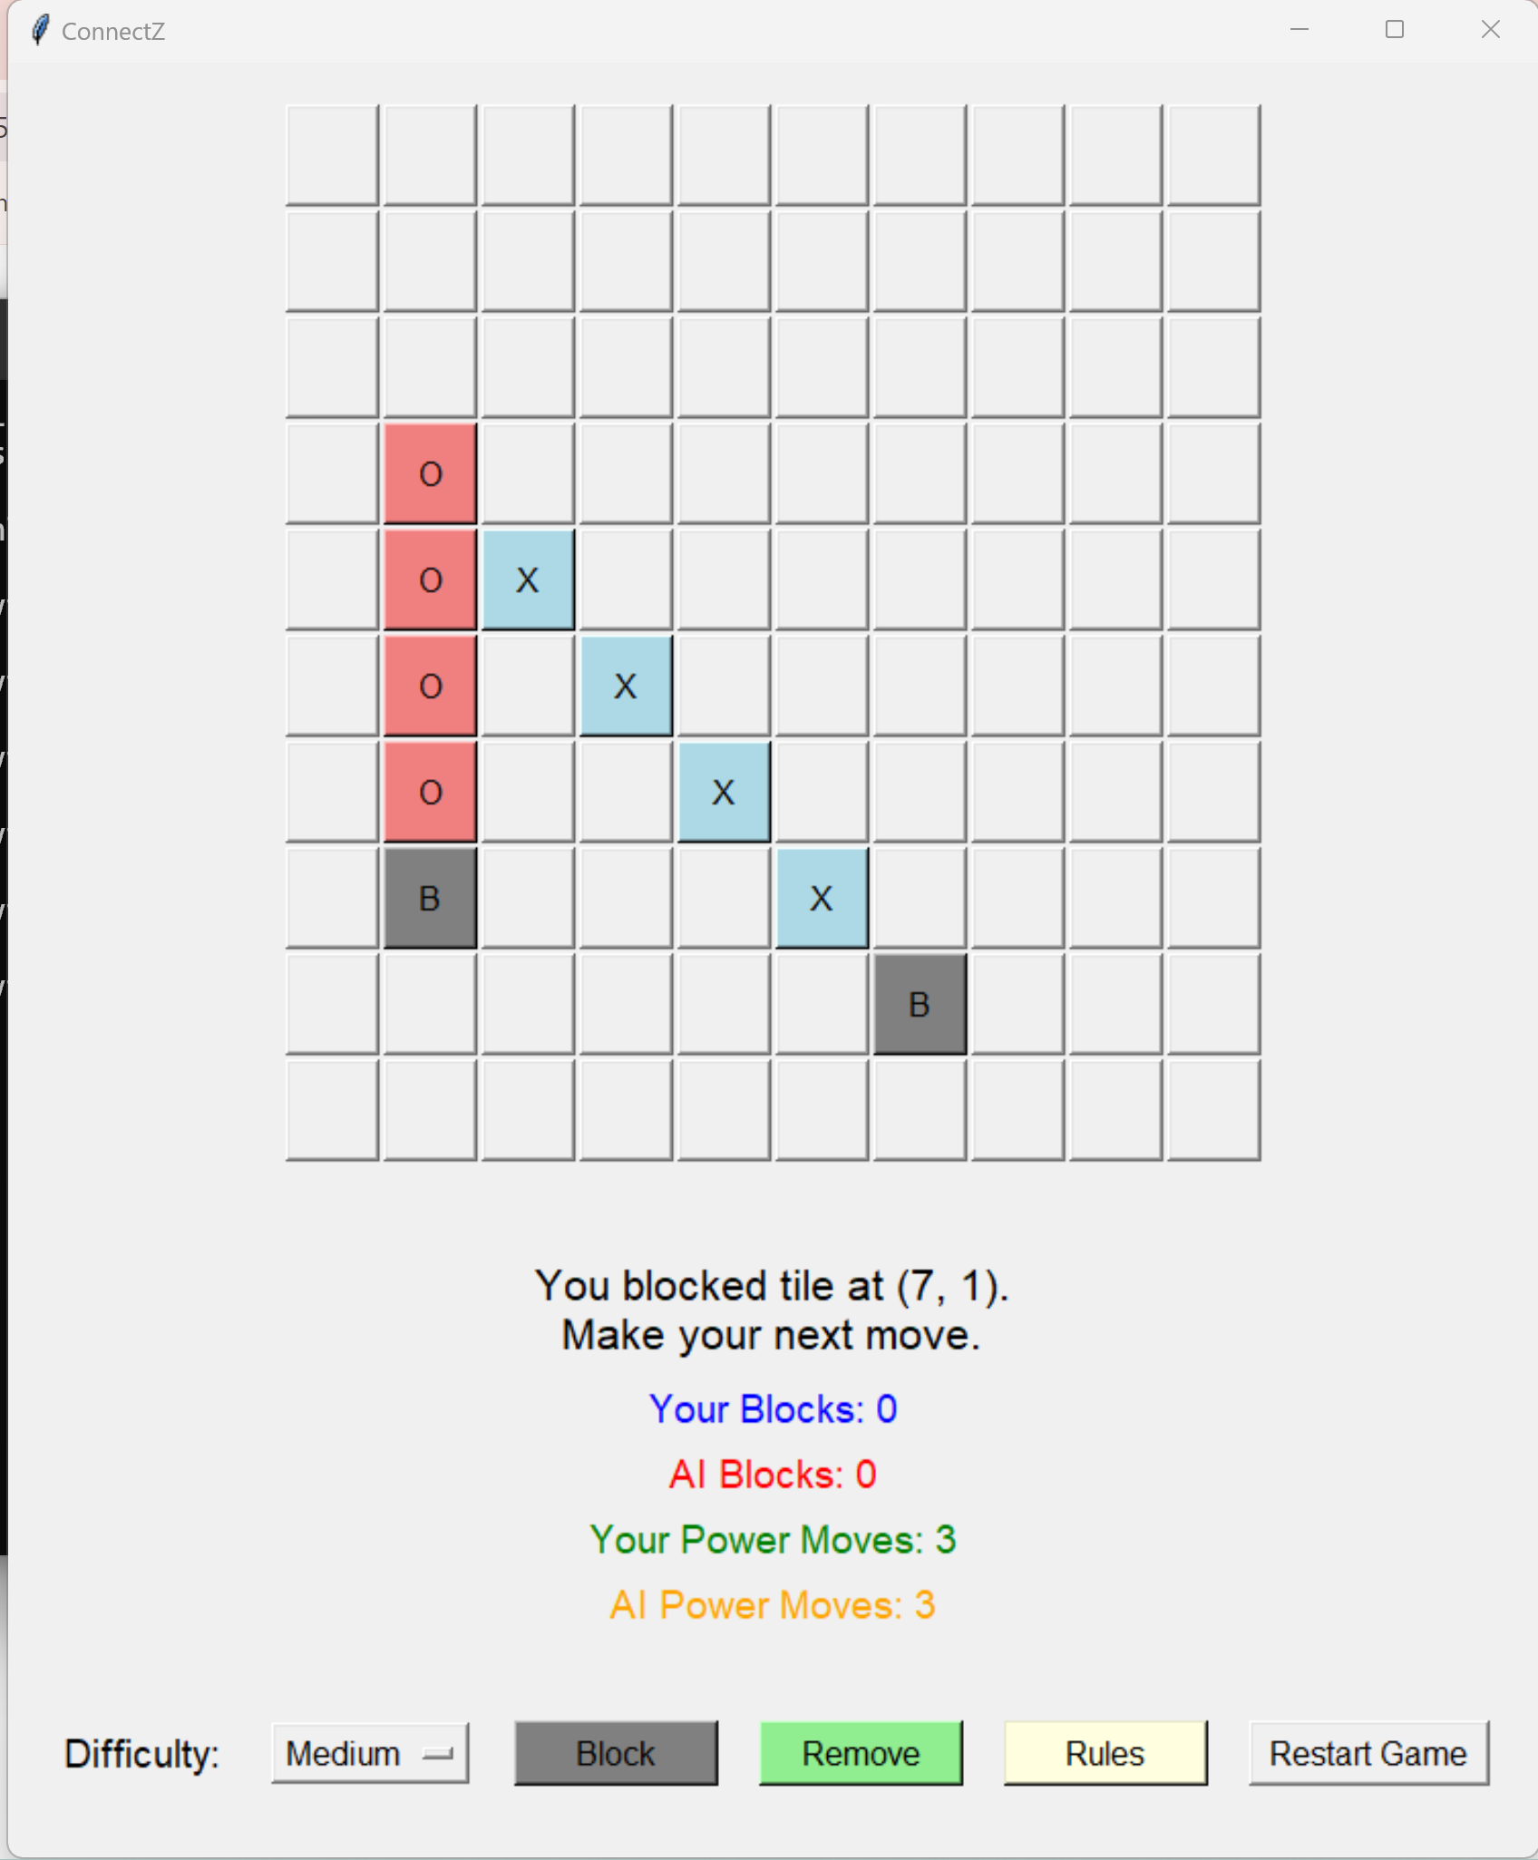
ConnectZ: Special Moves
Block Moves:
Usage: Once per game.
Function: Block a specific cell, preventing any piece placement there.
Additional Benefit: Grants an immediate additional move after blocking.

Slide 6
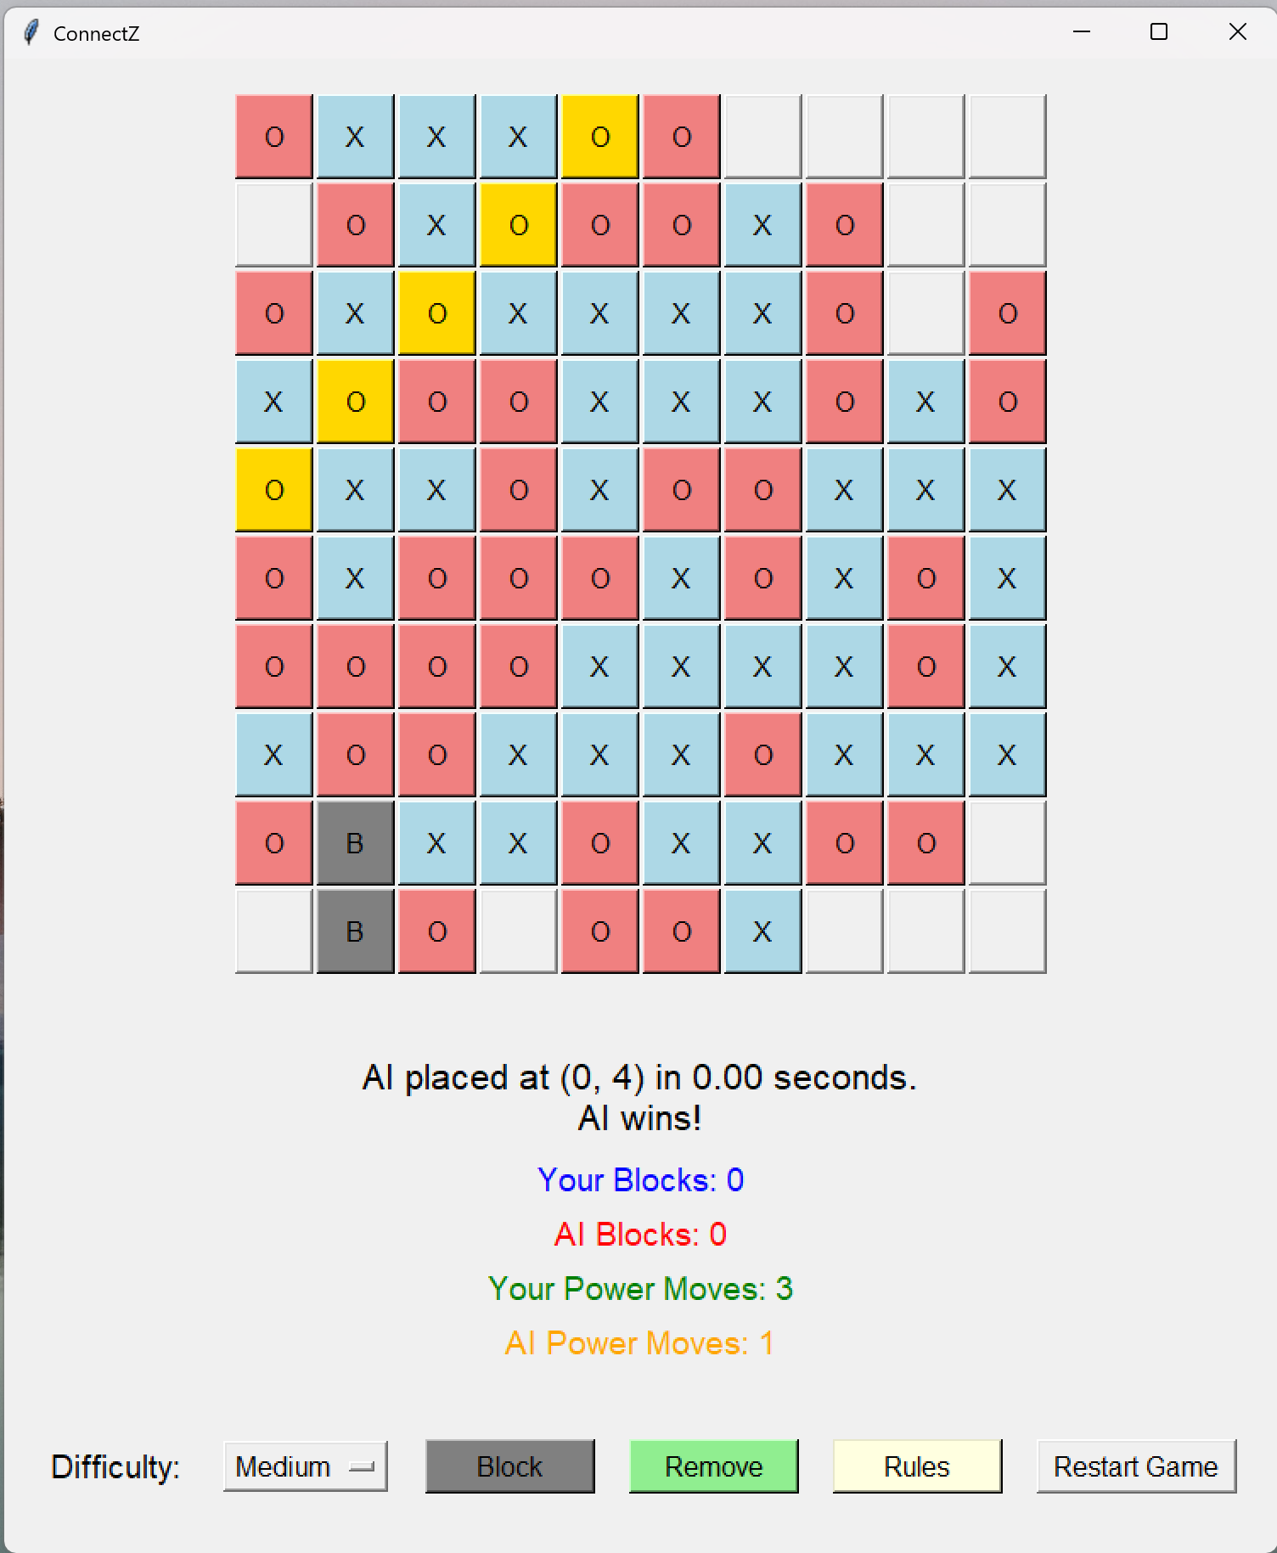
Gameplay Mechanics
Game Setup:
10x10 grid initialized with empty cells.
Players take turns placing their pieces ('X' or 'O').
Placing Pieces:
Click on any empty cell to place your piece.
The GUI updates to reflect the move with color-coded pieces.
Using Power Moves:
Activate by selecting the Remove option.
Choose an opponent's piece to remove, disrupting their strategy.
Limited to 3 uses per player.
Using Block Moves:
Activate by selecting the Block option.
Choose an empty cell to block, preventing opponent placement.
Grants an additional move after blocking.
Limited to 1 use per player.
Winning the Game:
First to align 5 consecutive pieces wins.
Game ends in a draw if the board is full without any winning sequence.

Slide 7
AI Implementation
MINIMAX ALGORITHM
ALPHA-BETA PRUNING
HEURISTIC EVALUATION
Optimization Technique: Reduces the number of nodes evaluated in the Minimax tree.
Function: Eliminates branches that won't influence the final decision, enhancing efficiency.
Benefit: Enables deeper search within limited computation time.
A decision-making framework for adversarial games.
Simulates all possible moves to determine the optimal strategy.
Assumes both players play optimally to maximize their chances of winning.
Purpose: Assigns scores to non-terminal board states to estimate the desirability of a position.
Factors Considered:
Potential to create or block winning sequences.
Utilization and conservation of Power Moves.
Strategic placement and blocking of key cells.

Slide 8
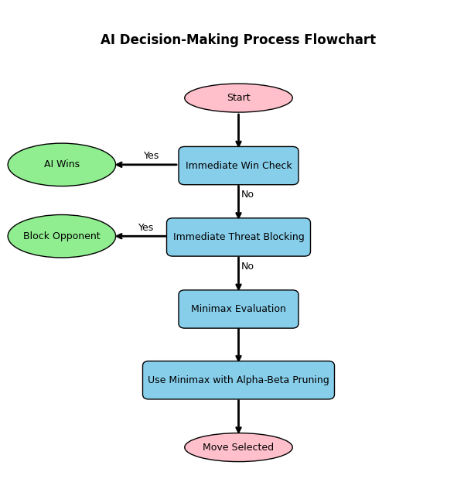
AI Decision-Making Process
Immediate Win Check: AI looks for moves that result in an immediate win.
Immediate Threat Blocking: AI blocks any move that could lead the human player to win.
Minimax Evaluation: If no immediate actions are required, AI uses Minimax with Alpha-Beta Pruning to decide the best move based on heuristic scores.

Slide 9
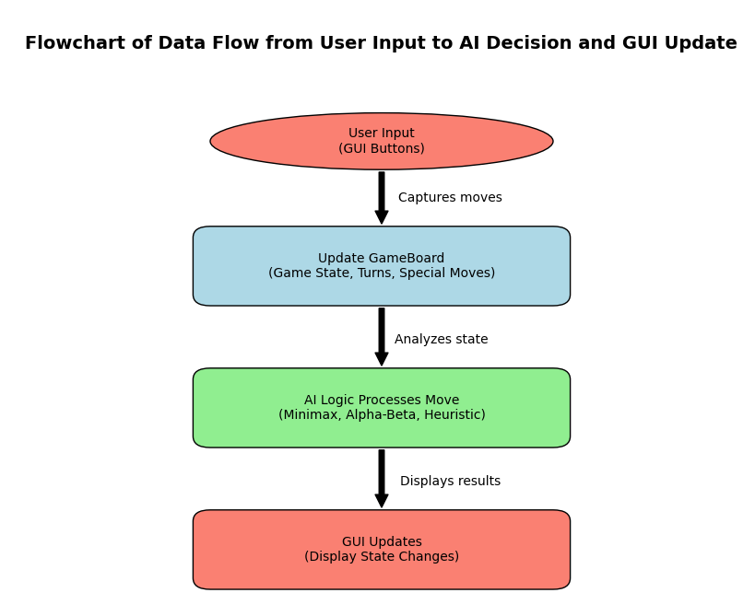
Technical Architecture
Core Components:
GameBoard Class:
Manages the game state, including the board, turns, and special moves.
Implements game rules and win condition checks.
AI Logic:
Minimax Function: Recursively evaluates potential moves.
Alpha-Beta Pruning: Optimizes the search process.
Heuristic Evaluation: Scores board states for decision-making.
ConnectZGUI Class:
Handles the graphical user interface using Tkinter.
Manages user interactions, button states, and game updates.
Data Flow:
User Interaction: User inputs are captured via GUI buttons.
Game State Update: GameBoard processes moves and updates the state.
AI Processing: AI analyzes the current state to determine and execute its move.
GUI Refresh: Updates are reflected in the GUI, showing the latest game state.
Libraries and Tools:
NumPy: Efficient board state management.
Tkinter: Responsive and interactive GUI.
Threading: Ensures AI computations do not freeze the GUI.

Slide 10
Time Complexity
Minimax with Alpha-Beta Pruning:
Standard Minimax: O(b^{d}) complexity, where the branching factor and depth determine the number of potential moves to evaluate.
Alpha-Beta Pruning: Reduces effective time complexity to O(b^{(d/2)}) in the best case, allowing for deeper searches without exponential time increases.
Heuristic Evaluation Function:
Complexity: O(n), where n is the number of cells. The function evaluates each cell to score the board state, influencing overall time complexity.
Immediate Move Checks:
Complexity: Generally, operates in constant time, O(1), for detecting immediate wins or blocks, reducing the need for deeper Minimax computations.
Difficulty Levels and Adjustable Search Depth:
Complexity Adjustment: Varies with the set difficulty level; Easy (d=2) results in O(b²), Medium (d=3) in O(b³), and Hard (d=4) in O(b⁴), providing scalability and performance management.

Slide 11
Space Complexity
Minimax Tree Storage: The space complexity of storing the game tree, which is O(b*d), where b is the branching factor (average number of legal moves per turn), and d is the search depth.
Practical Limits: For a 10x10 board with a reasonable depth, the space consumption remains manageable on modern systems, largely influenced by the game tree depth and branching factor.
Game State Representation: The board is represented using a NumPy array of size 10x10, resulting in a constant space complexity of O(n), where n = 100 (cells on the board).
GUI Components: Each cell on the 10x10 board corresponds to a Tkinter button, adding to the overall space complexity, which is O(n) based on GUI elements.

Slide 12
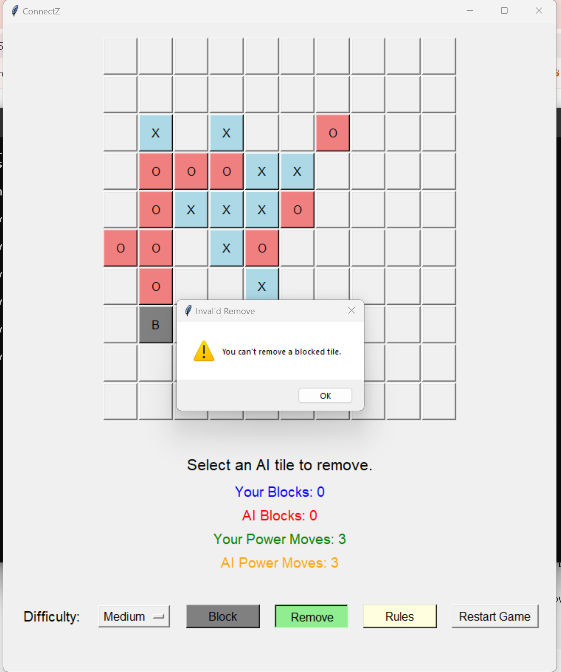
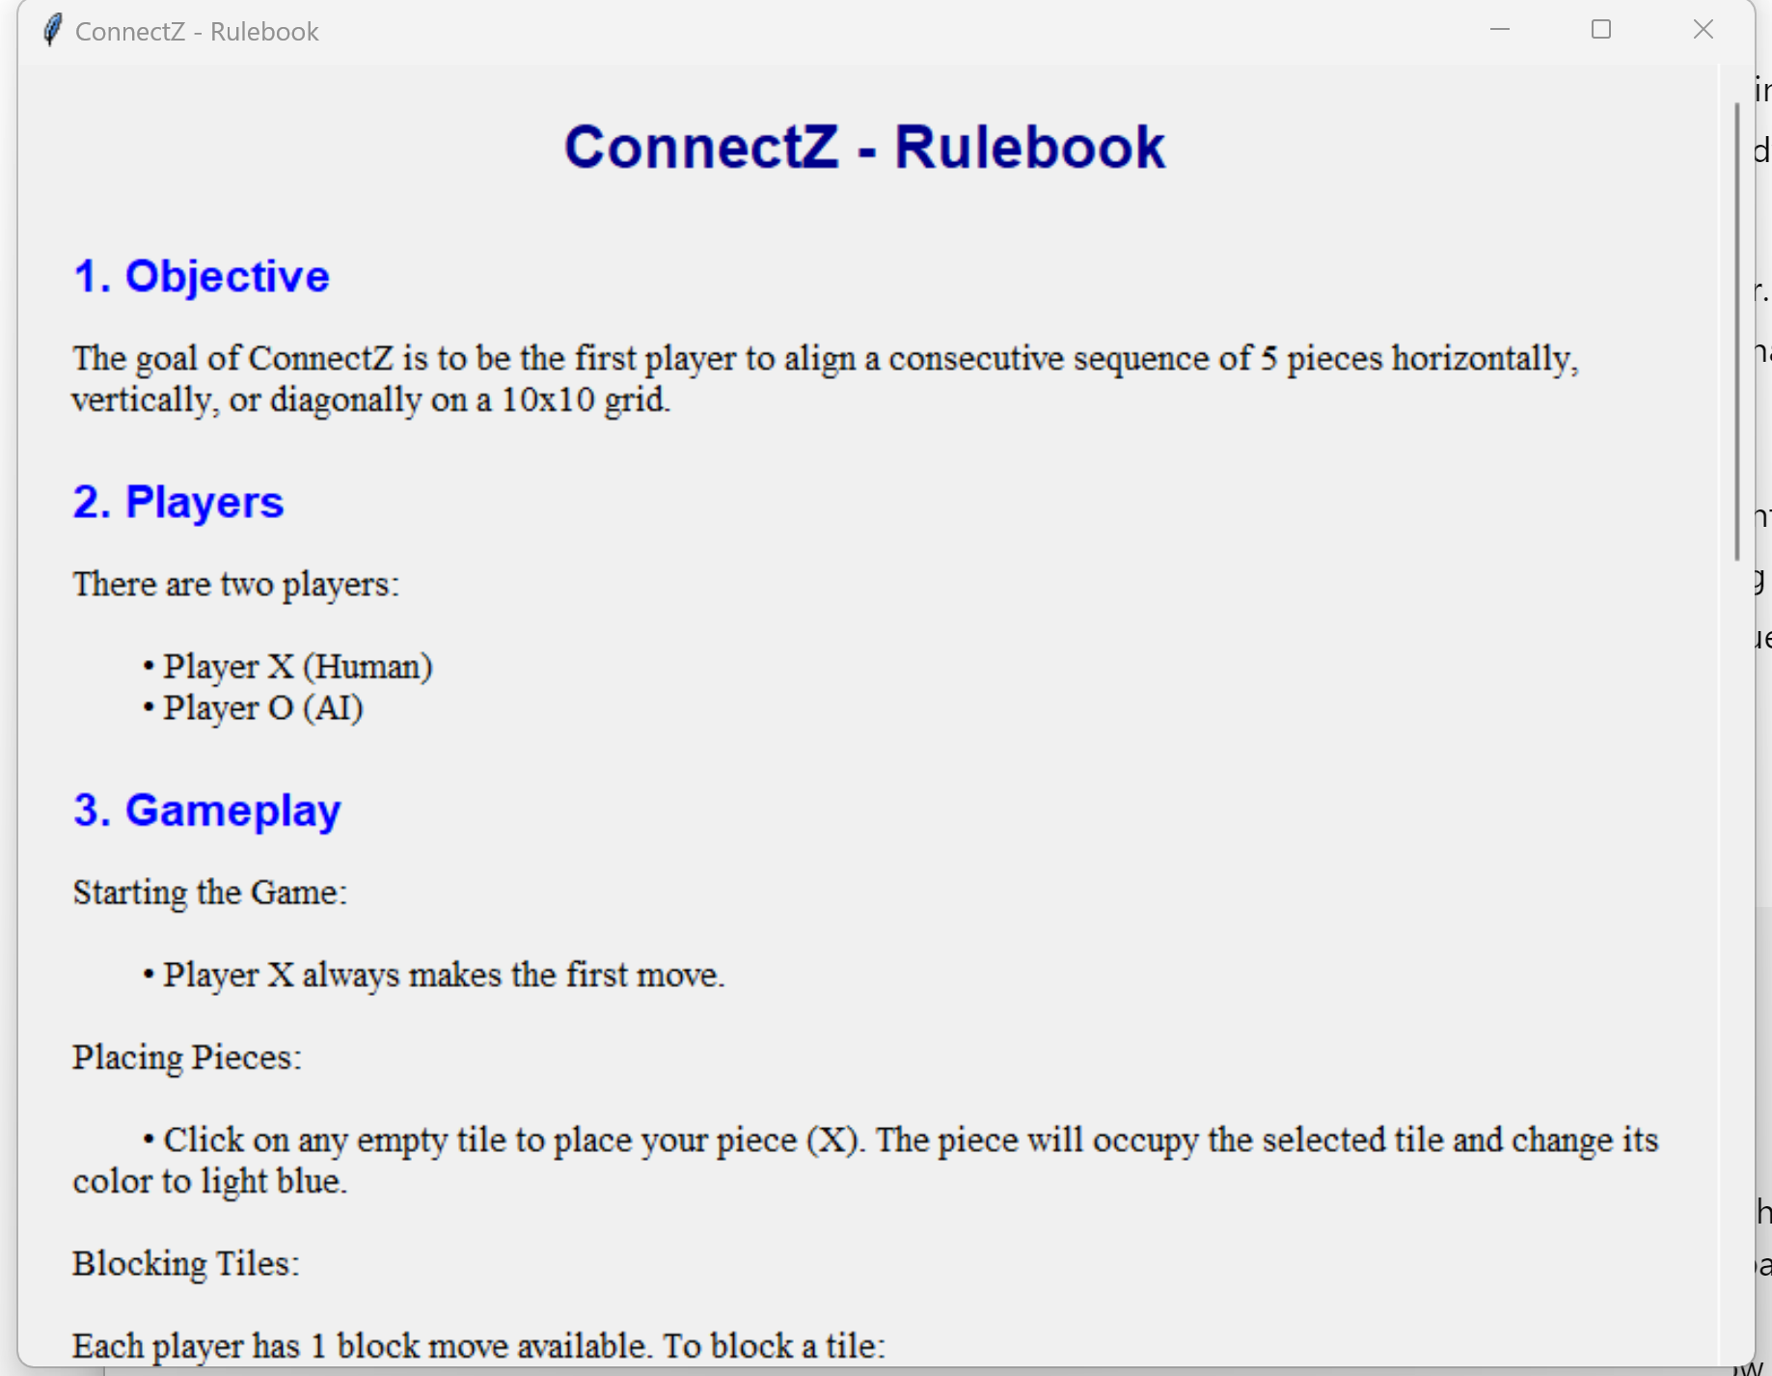
Windows Application

Slide 13
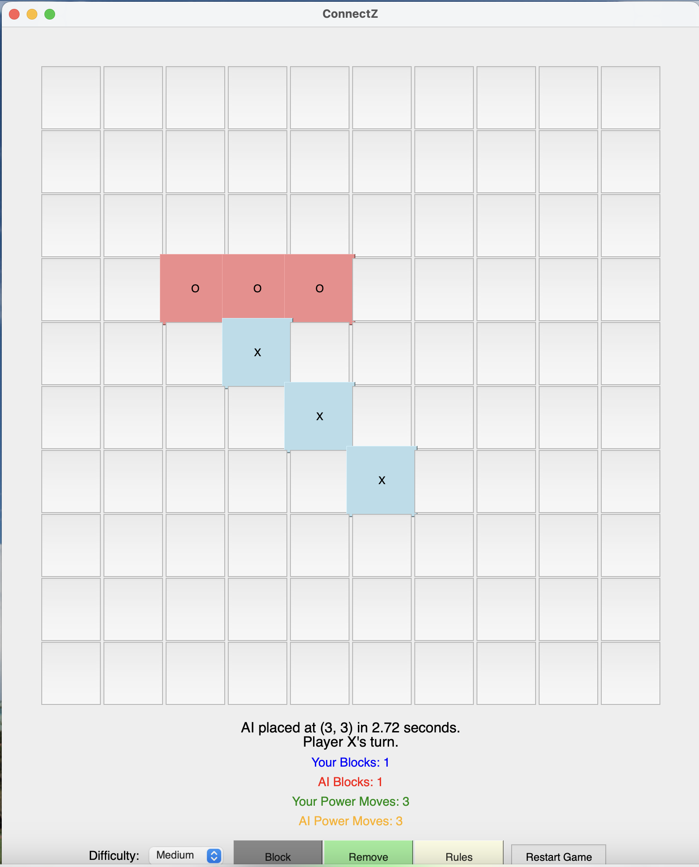
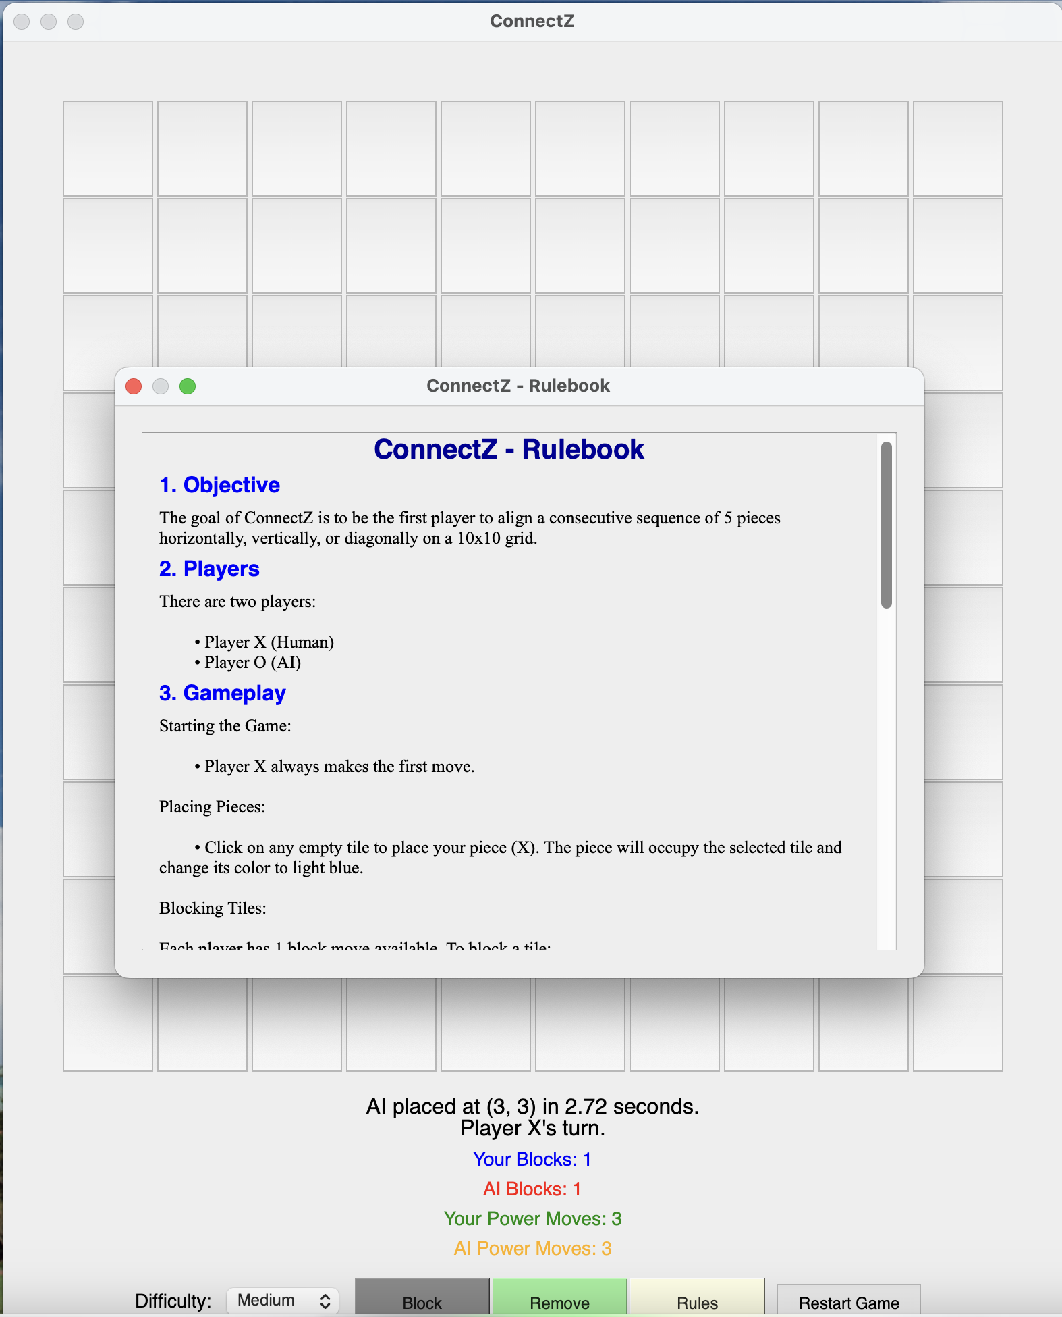
MacOS Application

Slide 14
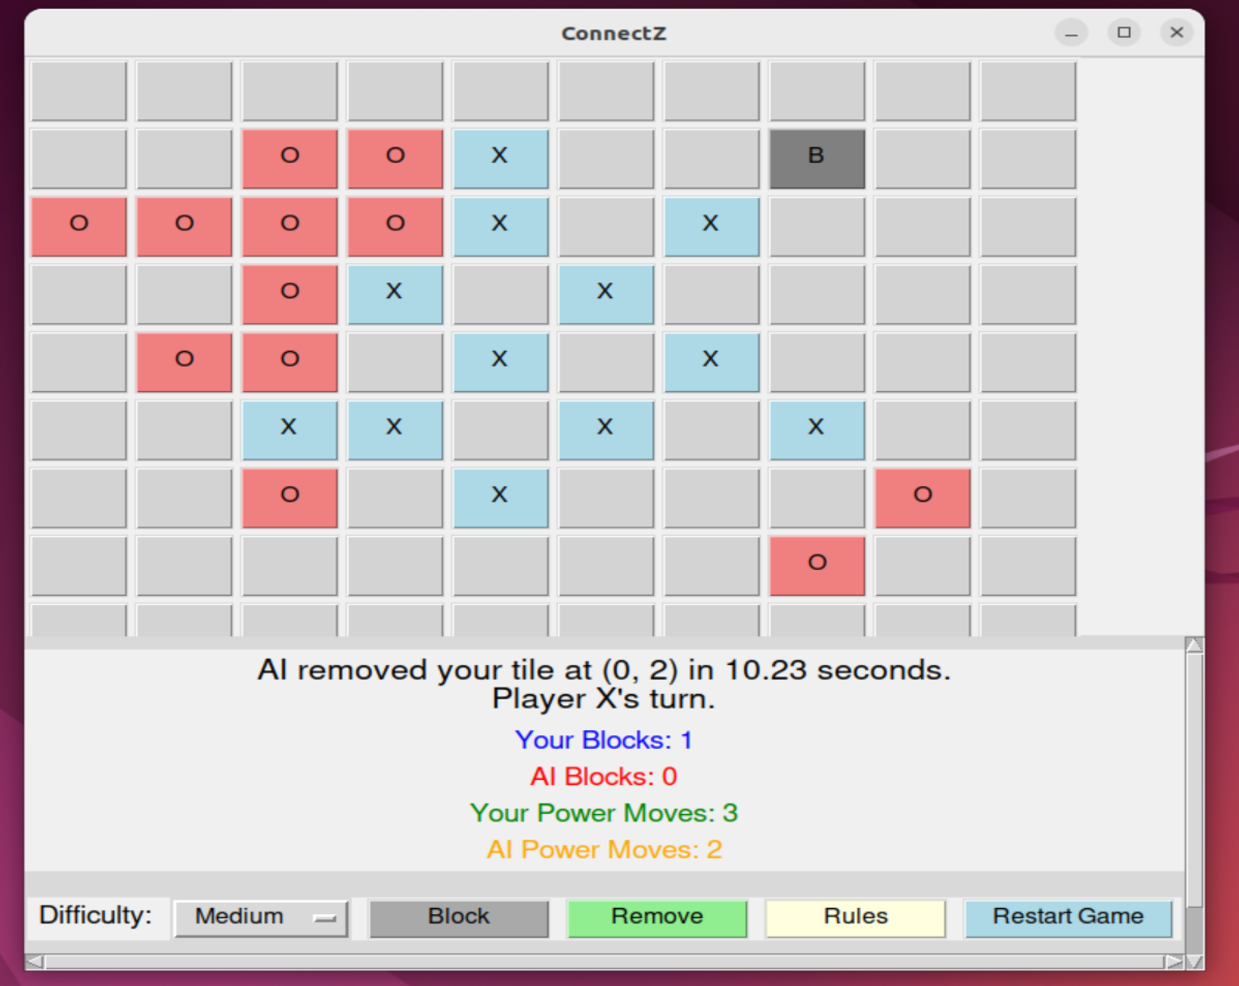
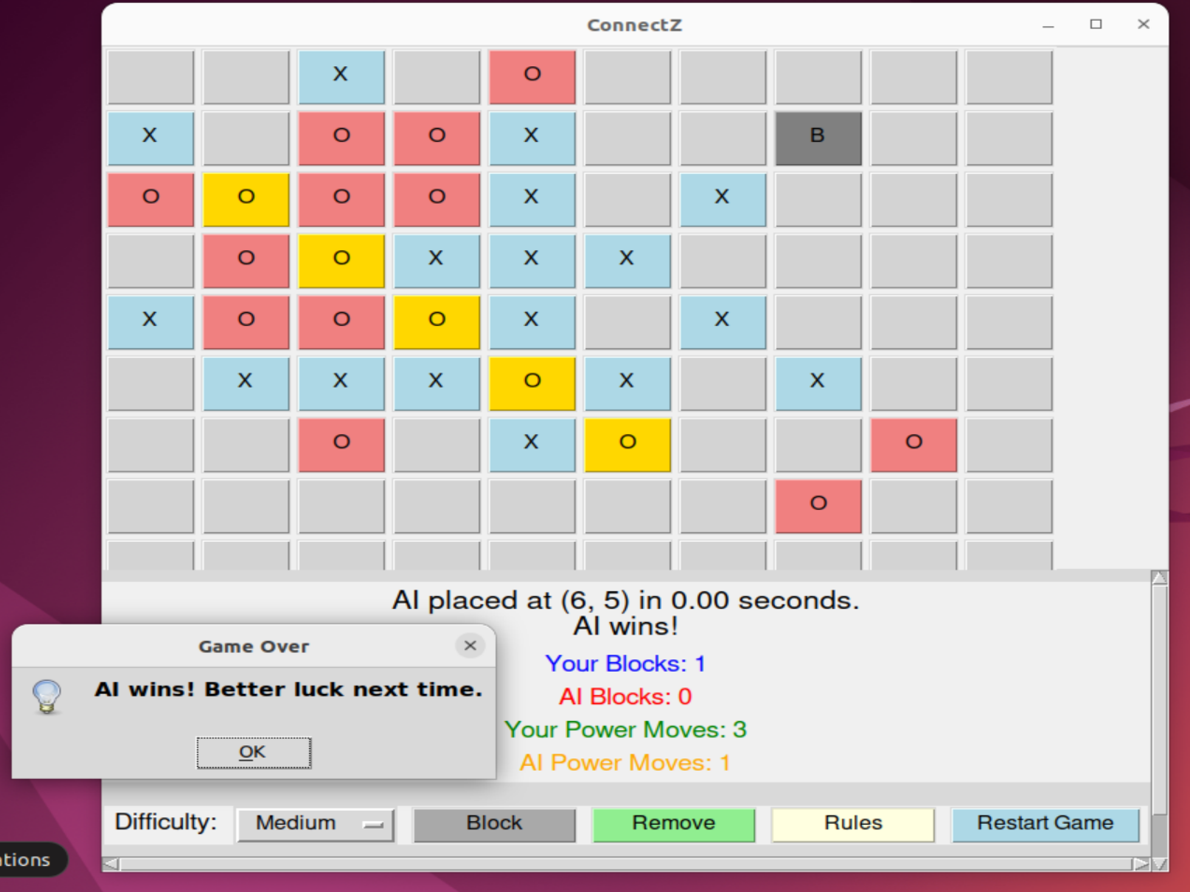
Linux Application

Slide 15
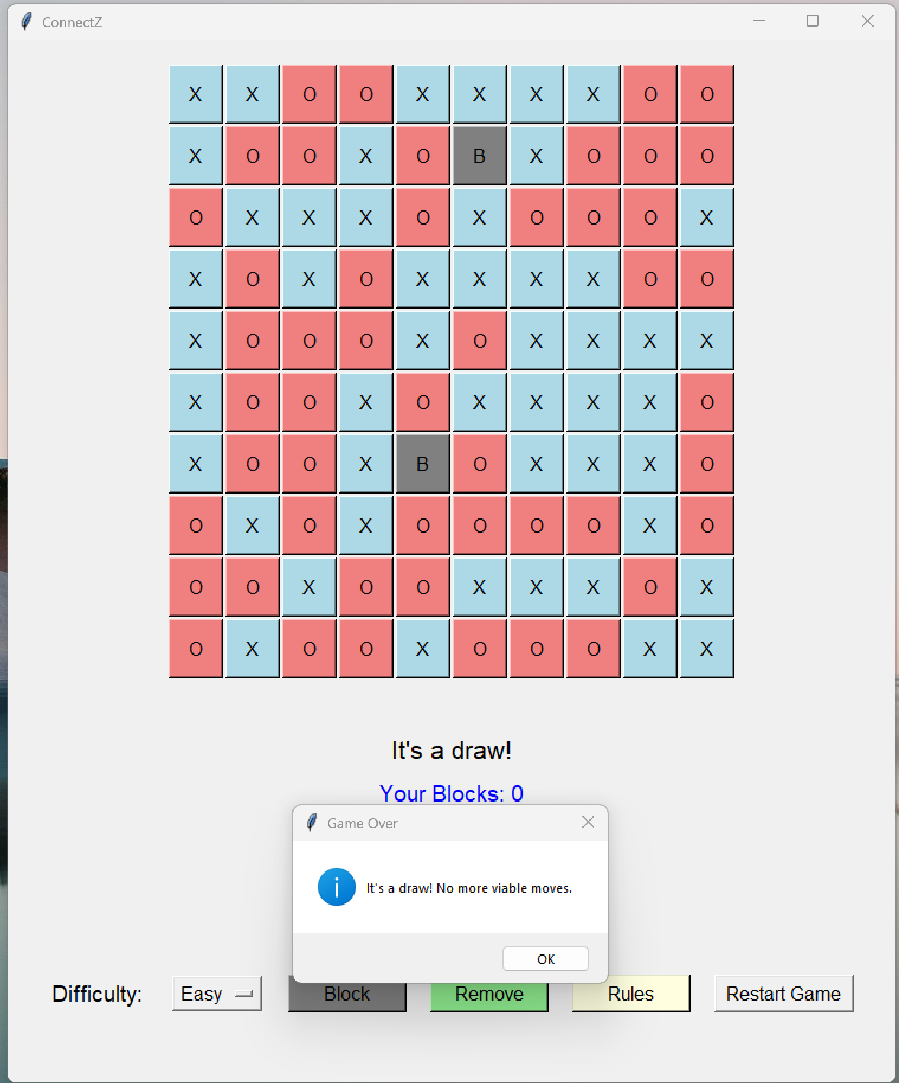
Challenges Faced
AI Logic Complexity:
Difficulties: Implementing an efficient Minimax algorithm with Alpha-Beta Pruning.
Solution: Optimizing the pruning conditions and heuristic evaluations to balance performance and decision quality.
GUI Integration:
Challenges: Ensuring a responsive and intuitive user interface that accurately reflects game states and AI moves.
Solution: Utilizing threading to handle AI computations without freezing the GUI and carefully managing button states.
Game Balancing:
Issues: Ensuring the game remains fair and challenging for both human players and the AI.
Approach: Fine-tuning heuristic evaluation parameters and adjusting AI search depth based on difficulty levels.
Performance Optimization:
Problem: Managing computation time for the AI, especially at higher search depths.
Strategy: Implementing Alpha-Beta Pruning effectively and limiting search depth based on selected difficulty.
Handling Special Moves:
Complexity: Integrating Power Moves and Block Moves into both game mechanics and AI decision-making.
Solution: Extending the Minimax algorithm to account for these unique actions within the game state evaluation.

Slide 16

Lessons Learned
Algorithm Optimization:
Importance of optimizing AI algorithms to balance performance and strategic depth.
User Interface Design:
Designing intuitive and responsive GUIs requires careful planning and testing.
Game Balance:
Achieving a fair and engaging game involves iterative testing and refinement of game mechanics.
Problem-Solving Skills:
Tackling complex challenges enhances analytical and troubleshooting abilities.
Project Management:
Organizing tasks and managing time effectively are crucial for successful project completion.
Integration of AI and GUI:
Seamlessly integrating backend AI logic with frontend GUI demands clear communication between components.

Slide 17

Future Enhancements
Enhanced AI Capabilities:
Machine Learning Integration: Implementing learning algorithms to adapt AI strategies based on player behavior.
Dynamic Difficulty Adjustment: AI adjusts its difficulty in real-time based on player performance.
Multiplayer Support:
Enabling online multiplayer mode for competitive play against other humans.
Advanced GUI Features:
Animations: Adding move animations for a more engaging user experience.
Customization: Allowing players to customize the board size, target alignment, and piece colors.
Additional Game Modes:
Introducing varied game modes with different rules and objectives to increase replayability.
AI Move Explanation:
Providing insights or explanations for AI's moves to enhance player understanding and learning.
Mobile Platform Adaptation:
Developing a mobile-friendly version of ConnectZ for broader accessibility.
Comprehensive Testing:
Implementing extensive testing to ensure robustness and eliminate bugs.

Slide 18
Key Takeaways
AI in Games:
Demonstrates the effective use of AI algorithms to create intelligent and challenging opponents.
Balancing Complexity and Performance:
Achieving a balance between sophisticated game mechanics and smooth performance is crucial for user satisfaction.
Importance of Heuristics:
Heuristic evaluations are essential for guiding AI decisions in complex game states without exhaustive computations.
User-Centric Design:
Prioritizing an intuitive and responsive GUI enhances the overall gaming experience.
Problem-Solving and Adaptability:
Overcoming technical and design challenges fosters growth in problem-solving skills and adaptability.
Future Potential:
The project lays a strong foundation for further enhancements and scalability, showcasing the potential of integrating AI in interactive applications.

Slide 19
Thank you.

